Slide 1

ACTL3143 Project
Image Classification of Australian Animals
William Li

Slide 2
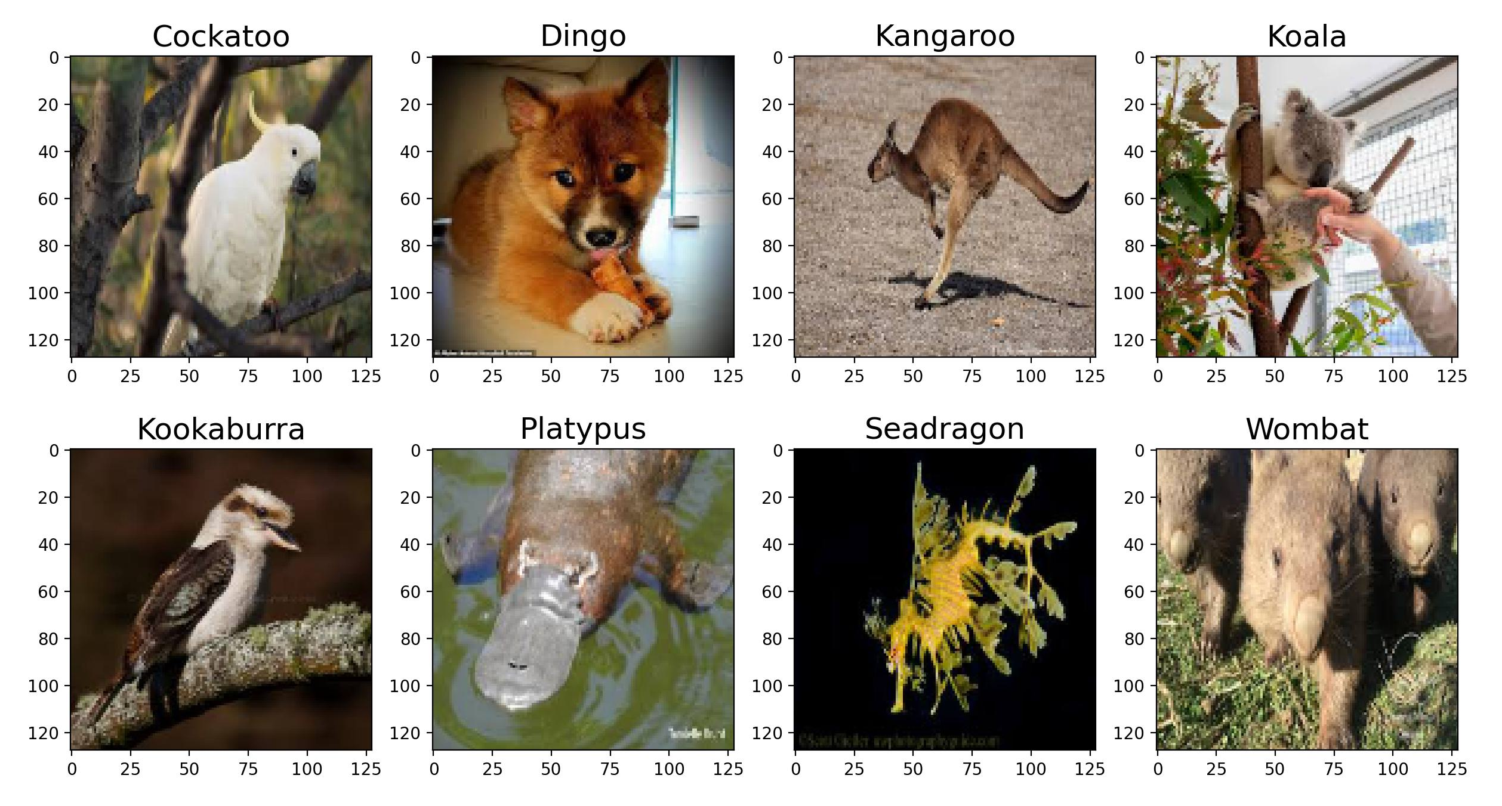
Project specification
Goal:
Highest accuracy
Notes:
I’ve chosen 8 animals to include in the dataset: Cockatoo, dingo, kangaroo, koala, kookaburra, platypus, seadragon and wombat. The goal is to find a model with the highest accuracy, which is the proportion of images it can label correctly.

Slide 3
The data
There are 200 images for each of the 8 animals
The data was downloaded from Google images with the help of the Image Downloader Chrome extension¹
I picked photos manually to ensure correct labels and try to avoid duplicates
1. https://chrome.google.com/webstore/detail/image-downloader/cnpniohnfphhjihaiiggeabnkjhpaldj

Slide 4
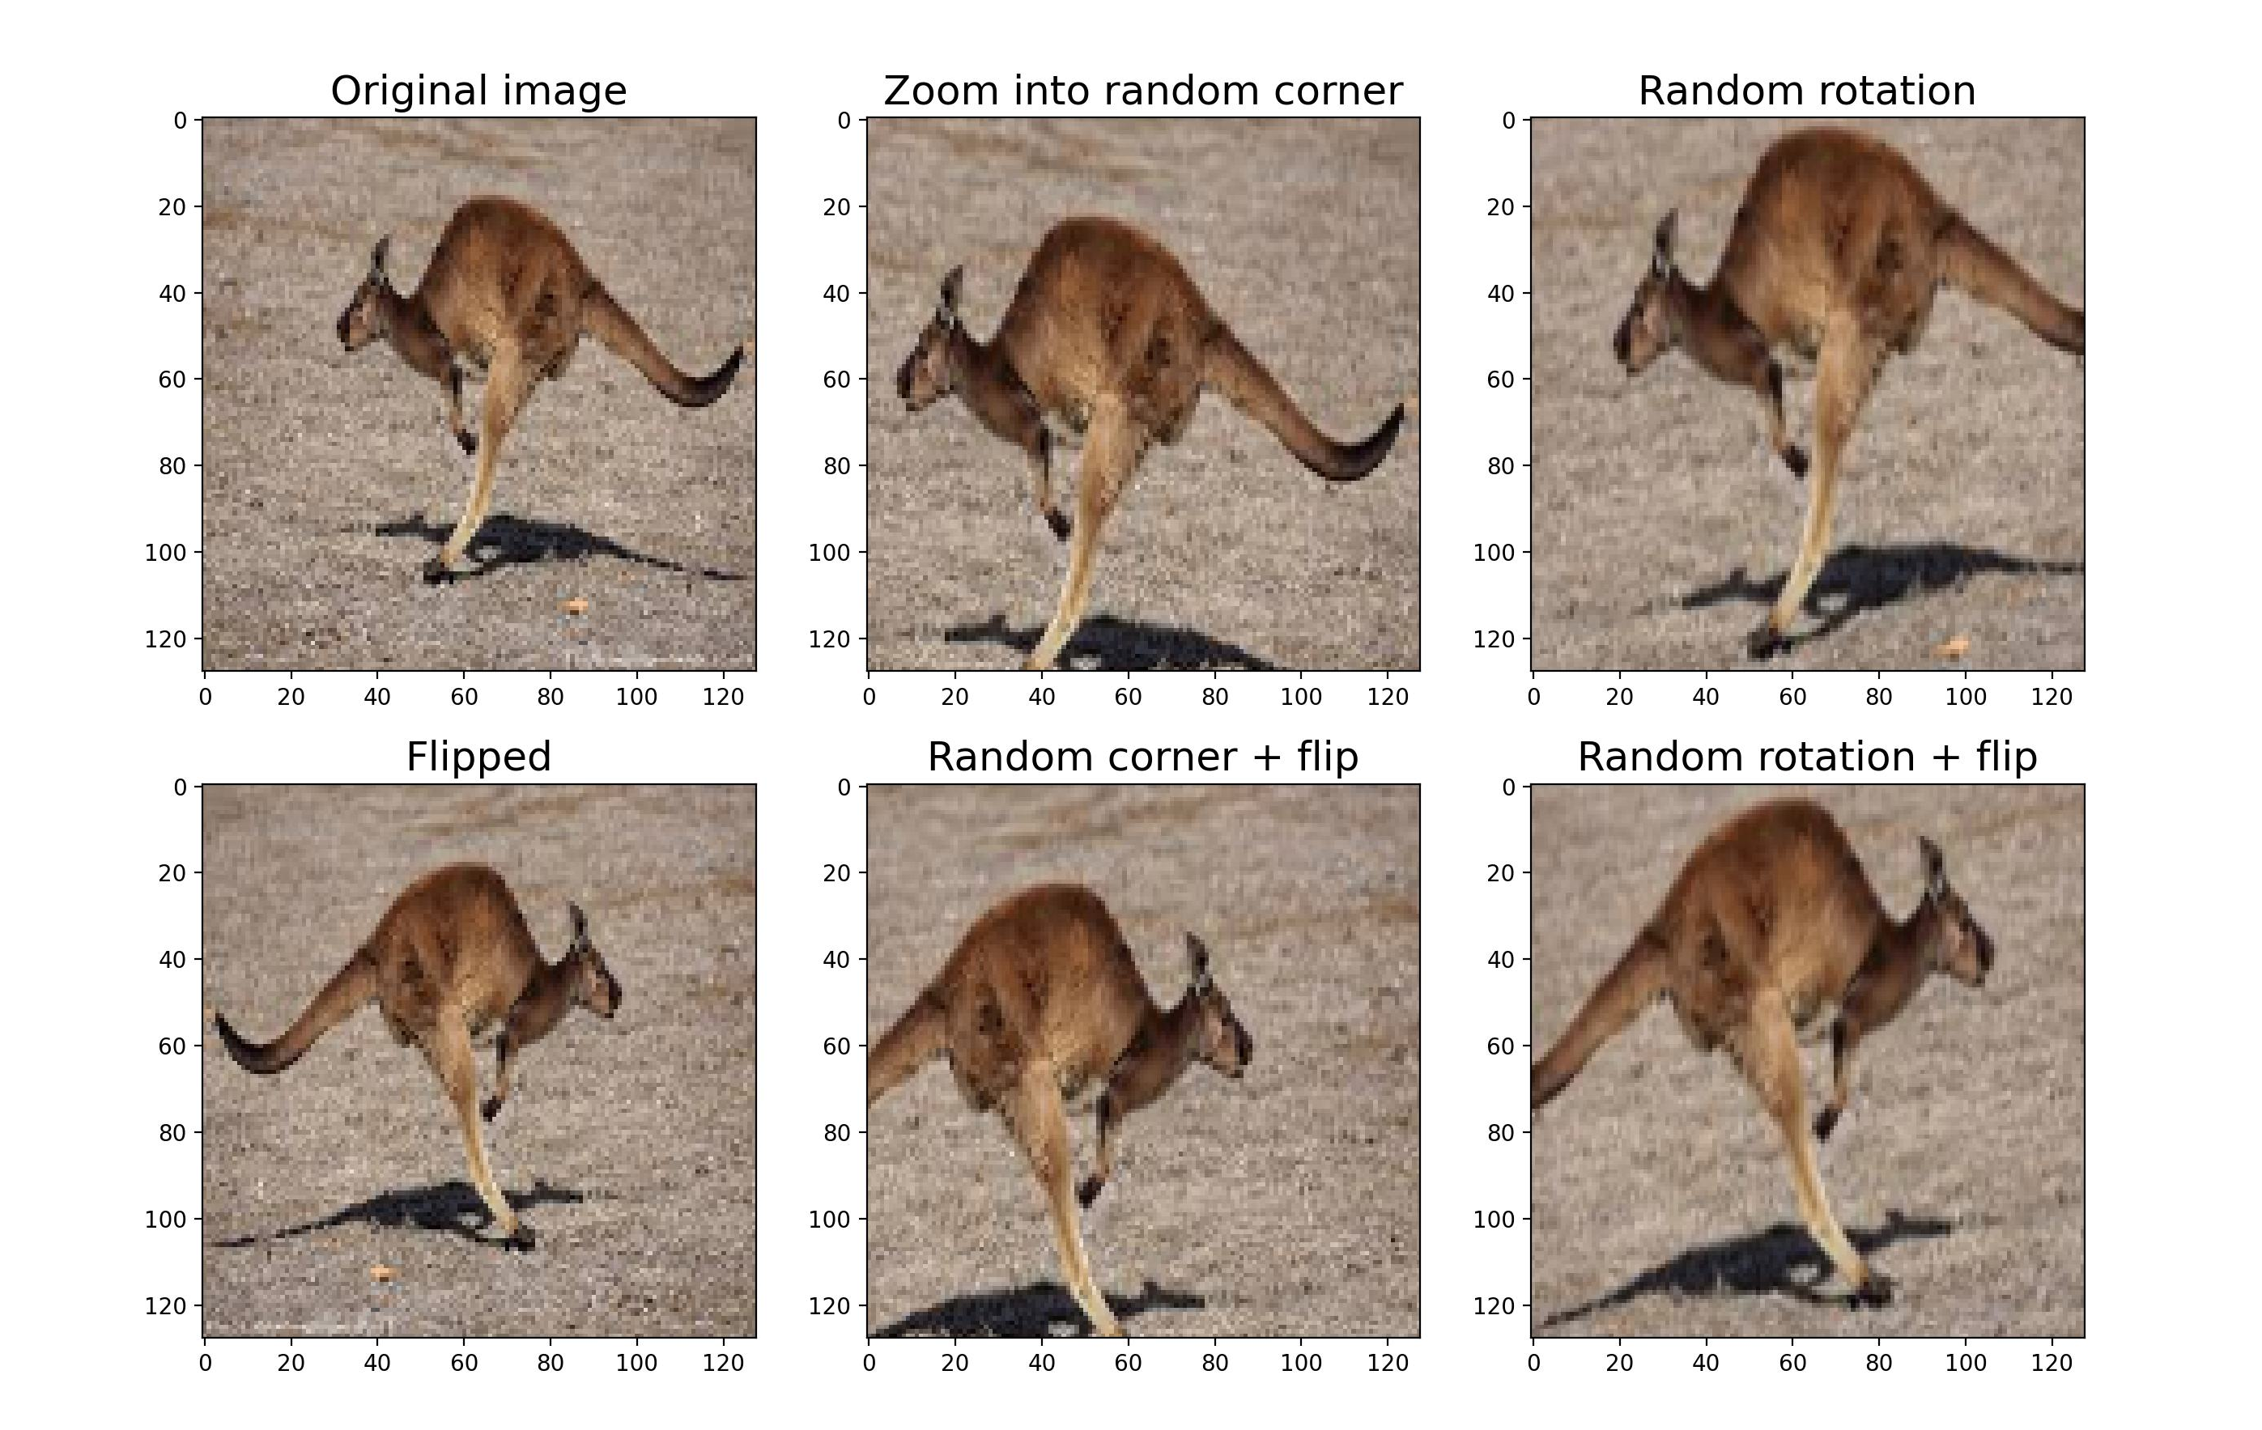
Data augmentation
Notes:
As the size of the dataset is fairly small, data augmentation was used on the training set to expand it to 6 times its original size. The operations used are a combination of zooming into a random corner, rotation, and flipping left to right.

Slide 5
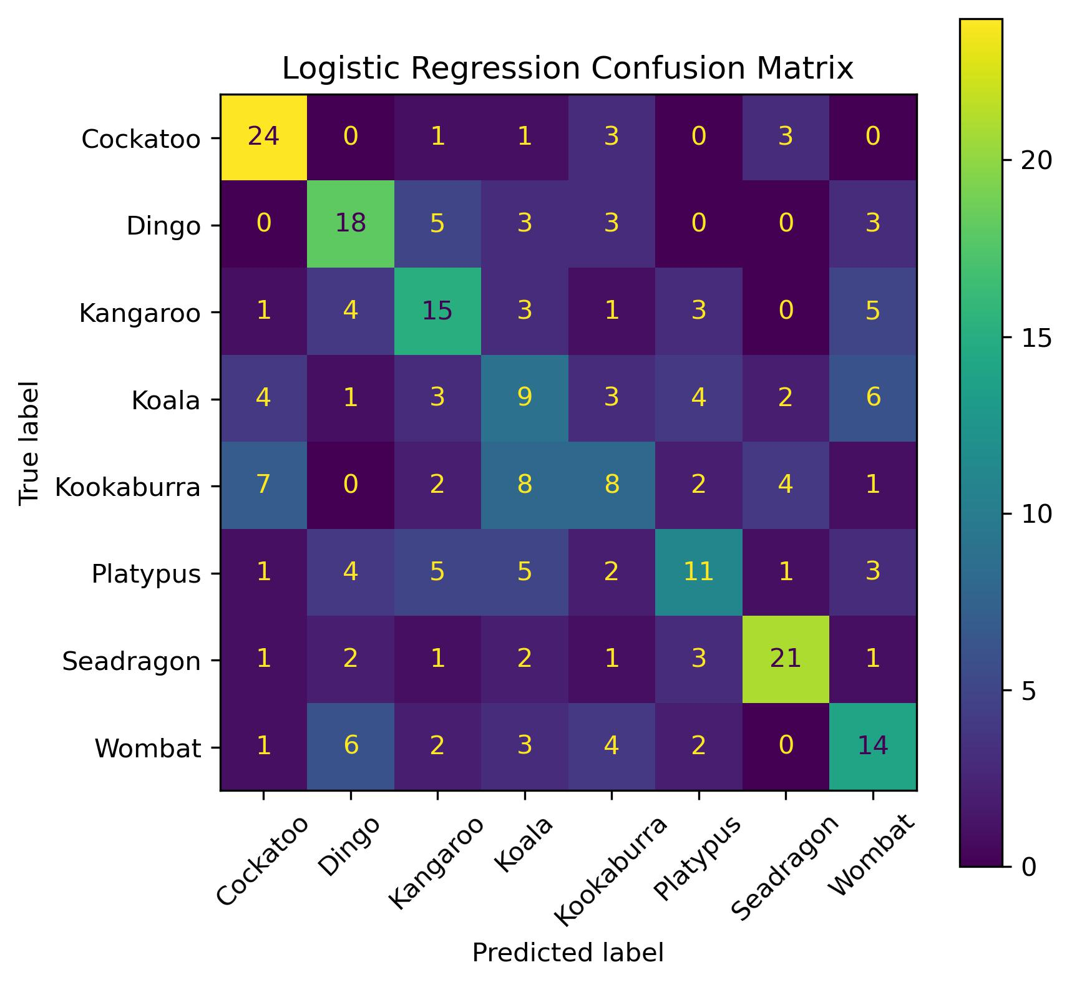
Logistic Regression
Accuracy on validation set: 46.9%
Notes:
The simple benchmark model of logistic regression gave an accuracy of 46.9%. This is not amazing but is substantially better than random guessing, which would have an accuracy of 12.5%.

Slide 6
Simple Neural network architecture
Resize:
to 16x16x3
Flatten
Input:
128x128x3 Image tensor
Dense layer:
1024 neurons
Tanh activation
Dense layer:
256 neurons
Tanh activation
Output:
1 of 8 classes
Dense layer:
8 neurons
Softmax activation
Notes:
The simple neural network are the most basic type of neural network. It uses Dense layers where every neuron receives an input from all neurons in the previous layer. I have also chosen to resize the image at the very start, as otherwise the input size will be way too large.

Slide 7
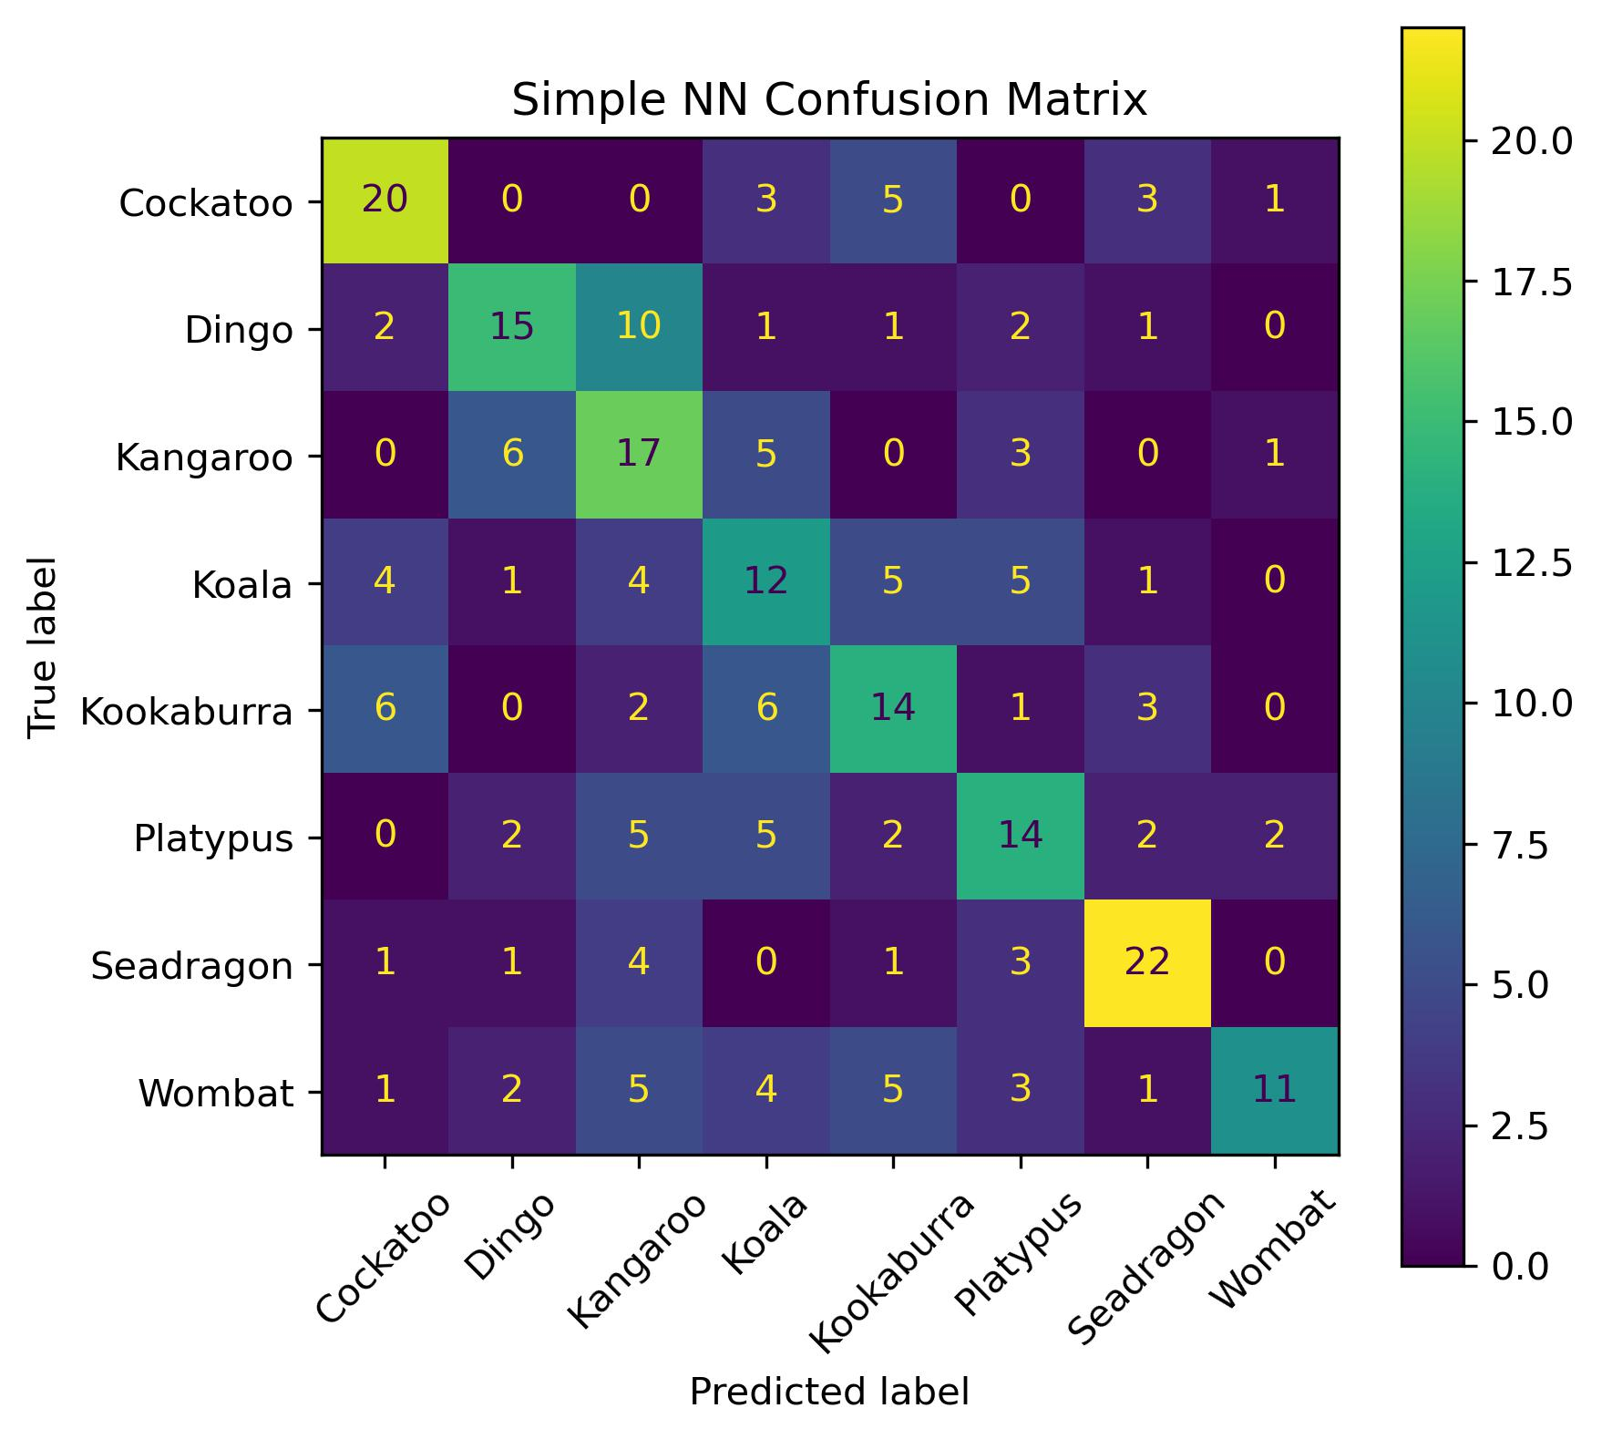
Simple Neural Network
Accuracy on validation set: 48.8%
Notes:
The simple neural network has an accuracy of 48.8%, which is only slightly better than logistic regression. The low performance is because immediately flattening the image into 1 dimension makes it loses information about the relative locations of input pixels.

Slide 8
Convolutional neural network
Convolution:
64 11x11 kernels
4 stride
tanh activation
Max Pooling:
2x2
2 stride
Convolution:
128 3x3 kernels
1 stride
tanh activation
Max Pooling:
2x2
2 stride
Convolution:
256 3x3 kernels
1 stride
tanh activation
Flatten
Dropout 0.4
Input:
128x128x3 Image tensor
Dense layer:
64 neurons
Tanh activation
Dropout 0.4
Max Pooling:
2x2
2 stride
Dense layer:
32 neurons
Tanh activation
Dropout 0.4
Dense layer:
8 neurons
Softmax activation
Output:
1 of 8 classes
Notes:
Convolutional neural networks are one of the most common models for image classification. It makes use of convolution layers, which use kernels that move across the previous layer to identify features within neighbouring pixels. The model uses pooling layers, which groups information and reduces output size. After convolution and pooling, it is flattened into a single dimension and fed into a dense network. The architecture I am using is shown here, which was inspired by classic CNN models such as LeNet and AlexNet. Some of the exact values I’m using were found through hyperparameter tuning which we will get to later.

Slide 9
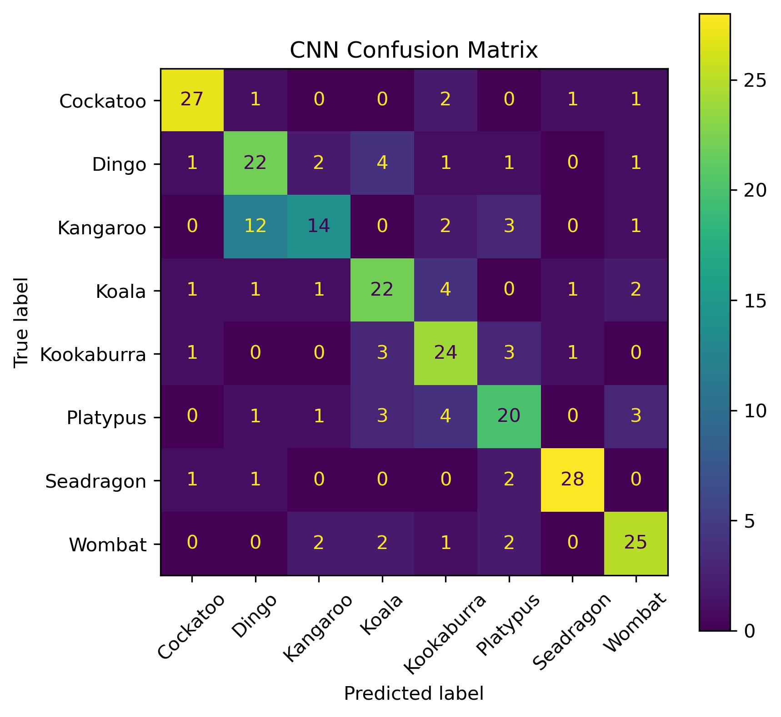
CNN
Accuracy on validation set:
71.1%
Notes:
The best CNN resulted in a 71.1% accuracy on the validation set. This is substantially better than the other two models, which is expected. The confusion matrix shows that it performs well for most classes, but often mistakes kangaroos for dingoes.

Slide 10
Grid search parallel plot

Slide 11
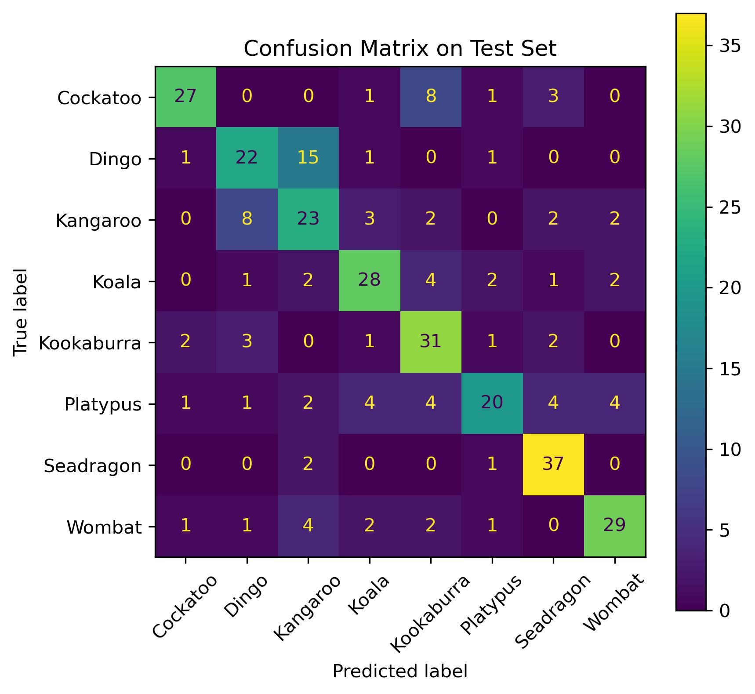
CNN on test set
Accuracy: 67.8%

Slide 12
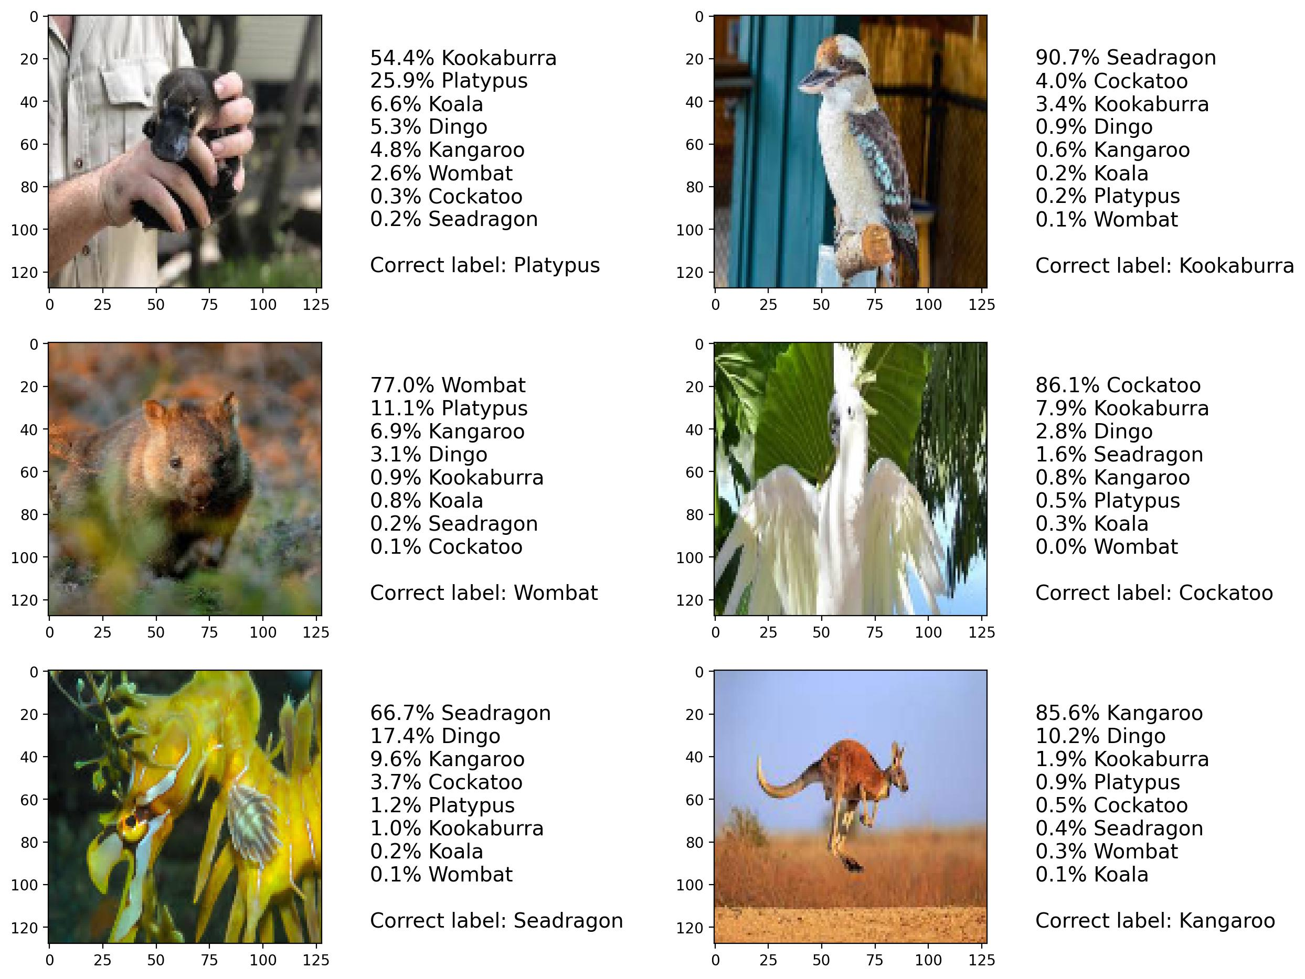
Predictions on test set

Slide 13
Thank you for listening!

Slide 14


Splitting
Training set
96 per class
Validation set 1
32 per class
For early stopping
2 validation sets as using the same dataset to pick the ideal stopping epoch and
Validation set 2
32 per class
For hyperparameter tuning
Test set
40 per class

